Slide 1
Chapter 1 Introduction to Computers, Programs, and Python

Slide 2
Objectives
To understand computer basics, programs, and operating systems (§§1.2-1.4)
To describe the history of Python (§1.5)
To write and run a simple Python program (§1.5)
To explain the basic syntax of a Python program (§1.5)
To explain the importance of, and provide examples of, proper programming style and documentation (§1.7)
To explain the differences between syntax errors, runtime errors, and logic errors (§1.8)
To create a basic graphics program using Turtle (§1.9)

Slide 3
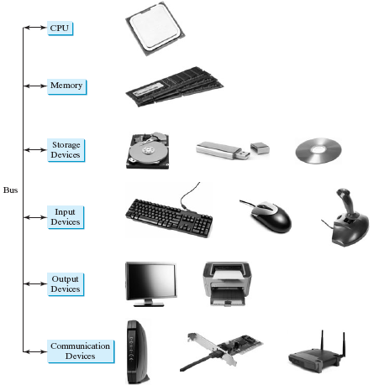
What is a Computer?
A computer consists of a CPU, memory, hard disk, floppy disk, monitor, printer, and communication devices.

Slide 4
CPU
CPU is the brain of the computer
It performs basic operations:
Add/Substract/Multiply/Divide numbers
Read and write values to memory
Branch to different parts of a program
Operation:
Retrieve instructions from memory
Execute the instruction
Built on small silicon chip that contains millions of transistors
Speed measured in gigahertz
Today’s processors run at 3-4 gigahertz
Multicore CPU is a CPU that has 2 or more independent cores

Slide 5
Bits and Bytes
Computer and memory is a series of switches
Each switch can be on or off. If on, value=1, otherwise value=0
0 and 1 are interpreted as digits in binary number system and called bits
Minimum storage unit is a byte (1byte = 8 bits)
Data such as numbers and characters are encoded as a series of bytes
Encoding scheme: set of rules that govern how a computer translates characters
E.g 1: To store 3, encode it with its bit representation 00000011
E.g 2: To store C, use ASCII encoding 01000011

Slide 6
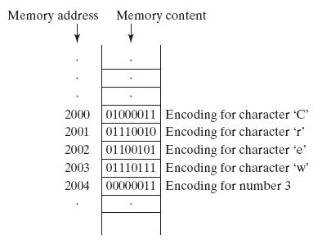
Memory
Memory is an ordered sequence of bytes for storing programs as well as data program is working on
Each byte has a unique address
Address used to locate byte for reading or writing data
Bytes can be accessed in any order (random-access memory or RAM)
Memory capacity is measured in bytes or multiples of bytes
1 megabyte(MB) is about 1 million bytes
1 gigabyte (GB) is about 1 billion bytes
1 terabyte (TB) is about 1 trillion bytes
4 or 8 GB are typical on today’s personal computers
Memory is built on silicon chips with millions of transistors
Less complicated, slower and less expensive compared to CPU chips
Memory is volatile: data in memory is lost when system turned off

Slide 7
Storage Devices
Since RAM is volatile, programs and data are permanently stored on storage devices
Programs and data are moved to memory when computer actually uses them
Storage devices are usually slower than RAM
Main types of storage devices
Magnetic disk drives
Optical disc drives (CD and DVD)
USB flash drives

Slide 8
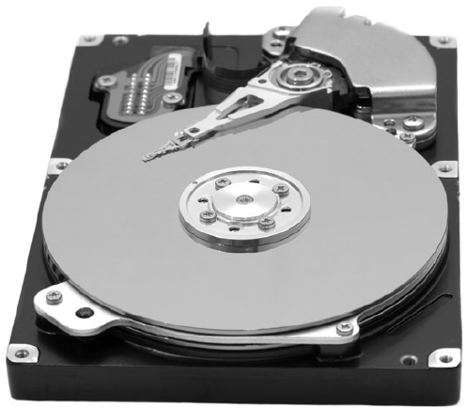
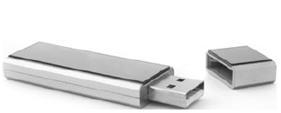
Disks, CDs, DVDs
Disks
A storage device that uses rotating platters
A head converts a magnetic signal from the platter to an electric signal
Head can also write data to the disk
To read/write data the head must be at the location of data
Head performs a ‘seek’ to a radial point
The disk constantly rotates so head can read relevant bits of data
A computer usually has at least one hard disk drive
Internal to the computer
External/removable hard disk drives are also available
CDs
CD: compact disk
CD-R: read-only permanent storage, user can not modify content once recorded
CD-RW: used like a disc, can write and overwrite data (typical for PCs)
Capacity is 700 MB
DVDs
DVD: digital versatile disk or digital video disk
DVD-R and DVD-RW types
Capacity is 4.7 GB
USB flash drives
USB (universal serial bus) allows connecting peripheral devices to computer
Can use it to connect printer, digital camera, mouse, external hard disk
USB flash drive is a portable hard drive that connect to USB port

Slide 9
Input and Output Devices
Allow the user to communicate with the computer
Input devices: keyboards and mice
Output devices: monitors
Keyboard
Device for entering input
Function keys (F1-F12) located across the top, their function depends on the software used
Modifier keys (Shift, Alt, Ctrl) modifies normal action of a key when pressed simultaneously
Arrow keys used to move pointer up, down, left and right on the screen
Insert, Delete, Page Up, Page Down has multiple uses (insert and delete text and objects, move up and down through a document one page at a time)
Numeric keypad is a separate set of keys styles like a calculator and used to enter numbers quickly
Mouse
Pointing device used to move a pointer around the screen or to click on screen objects
Monitor
Displays information
Screen resolution specifies number of pixels in horizontal and vertical direction
Typical resolution of 17-inch monitor is 1024x768
Dot pitch is amount of space between pixels and measured in millimeters

Slide 10
Communication Devices
Communication devices enable the computer to network with other computers
DSL (digital subscriber line) modem uses standard phone line to transfer data
Cable modem uses the cable TV line to transfer data (generally faster than DSL)
Network interface card (NIC) connects a computer to a local area network (LAN)
Can be wired or wireless

Slide 11
Programming Languages
Computers do not understand human language
We communicate with computers by writing programs in a language that a computer understands
A program, known as software, is a set of instructions that tells a computer what to do
There are hundreds of programming languages, however each computer understands one “native” language which is its machine language
Machine language
A computer’s native language: a set of primitive instructions
Instructions are in the form of binary code
Example: to add two numbers, you might write 1101101000110010
Programming in machine language is tedious, programs are difficult to read and modify

Slide 12
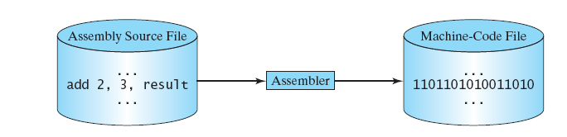
Programming Languages
Assembly language
Created as an alternative to machine languages
Uses a mnemonic to represent each of the machine language instructions
Example: to add two numbers, you might write add 2,3, result
Another program, assembler, translates assembly-language programs into machine code
Easier to write assembly code than writing machine code, but still tedious
Assembly language is machine dependent, and thus programs can’t be ported easily to another machine

Slide 13

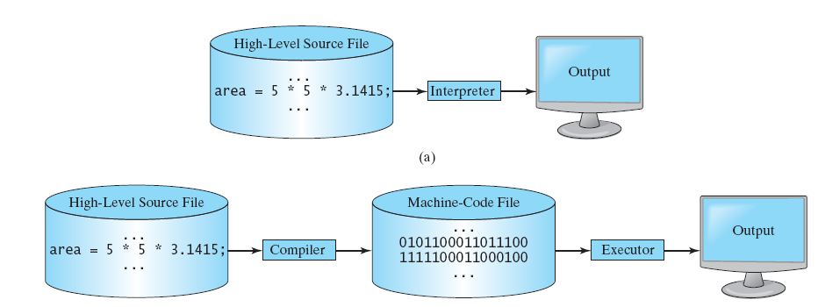
Programming Languages
High-level language
Machine independent: write once, and run on different machines
English-like and thus easier to learn and use
A program in a higher level language is a set of statements
Example: statement to compute the area of a circle
A program written in a high level language is called source program or source code
A source program must be translated to machine code for execution using a compiler or interpreted using an interpreter
Interpreter: reads one statement and performs the action(s) indicated by the statement
A compiler translates the entire source code in a machine-code file which is then executed

Slide 14
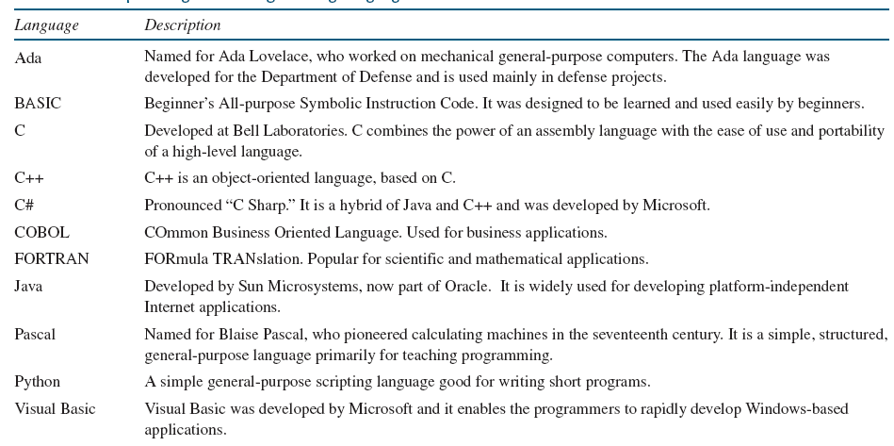
Popular High-Level Languages

Slide 15
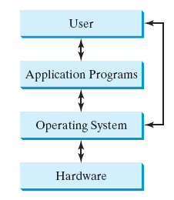
Operating Systems
An operating system (OS) manages and controls computer activities
Control and monitor system activities
Recognize input from keyboard
Send output to monitor
Manage files and folders
Ensure different programs and users don’t interfere with each other
Allocate and assign resources
Computer resources (CPU, memory, …) are shared between all programs
OS allocates such resources and assigns them to running programs based on various criteria
Examples:
Memory: every program has its own memory space independent of all other programs
CPU: OS allows multiple programs to run at the same time – each programs has a ‘virtual’ CPU
Hard disk: OS manages hard disk through supporting files/directories

Slide 16
The History of Python
Created by Guido van Rossum in 1990
Named after British comedy Monty Python’s Flying Circus
Python is a popular programming language widely used in industry and academia
Python is general-purpose programming language
Used in Google’s search engine
Mission-critical projects at NASA
Transaction processing at the New York Stock Exchange
Python is an interpreted programming language
Python is an object-oriented programming (OOP) language
Developed and maintained by Python Software Foundation
Two versions coexist
Python 2 and 3: 3 not backward compatible with 2
We will use Python 3

Slide 17
Getting Started with Python
Functions are important in programming languages
Abstracts the lines of code that define the function by a name
We can “call” or “invoke” the function using its name
A function is defined by its input and output
input: values that the function needs to perform its computation
We call the values we pass to a function arguments
output: the result of the computation
How do we know what arguments a function accepts?
We look at its documentation
How do we call or invoke a function?
We provide the function name followed by the arguments separated by commas
Computers store and manipulate information using 0s and 1s as we saw
How do we know whether 0011 represents 3 or some character?
The type of a value determines how Python understands and interprets it

Slide 18
Getting Started with Python
In examples that follow, we want to print characters on the screen
Python has string values that are sequence of characters that we enter on the keyboard
To create a string value surround a sequence of characters with double quotes
Example: “abc”, “Hello”, “123”
To create an integer value type the digits that make up the number
Example: 123, 34, 5

Slide 19
Getting Started with Python
Write a program to display Welcome to Python and Python is fun
Console: term is used to text entry and display devices of a computer
Console input: input from the keyboard
Console output: output to the monitor
Launching Python
Install Python on OS (see document in Week 1)
Can start by
Typing python at the command prompt
Running IDLE (Interactive Development Environment)
print statement: built-in function that can be used to display a string on the console
function: a group of statements that perform a specific task
We will often use the terminology “invoke a function” or “call a function” whenever we are using a function
built-in: provided by Python
string: A sequence of characters enclosed in quotes
Example: print(“Python is fun”)

Slide 20
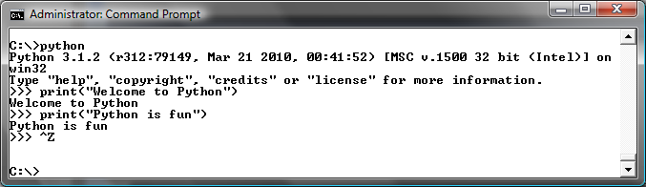
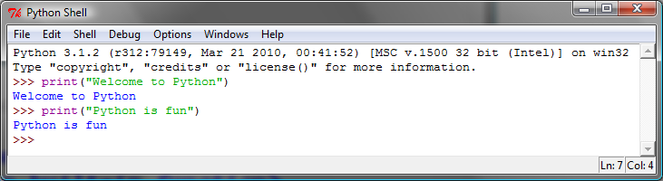
Getting Started with Python

Slide 21

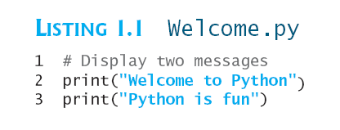
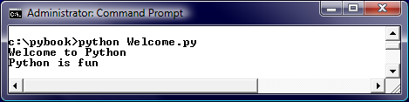
Creating and Running Python Source Code Files
Statements entered at Python prompt are not saved
To save statements, create a text file and then run the command:
Process is referred to as running Python in script mode
Filename is a Python source file or script file or module
Python files are named with the extension .py
Other alternatives
Use IDLE to create, save and modify a script
Use Eclipse
Popular development environment (IDE)
Check Supplement I.C and I.D on course website: www.cs.armstrong.edu/liang/py

Slide 22

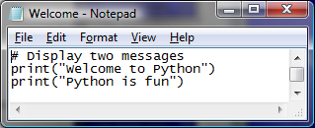
Creating and Editing Using Notepad
To use Notepad, type
notepad Welcome.py
from the DOS prompt.

Slide 23
A Simple Python Program
Line 1 is a comment
Documents what the program is
Helps programmers communicate and understand
Ignored by the interpreter
Line comments are preceded by a pound sign (#)
Interpreter ignores all text after #
Paragraph comments are enclosed by 3 single quotation marks (‘’’)
Interpreter ignores any text between quotation marks
No punctuation marks at end of statement
Python programs are case sensitive (print and Print are different)
Welcome
Run

Slide 24
Trace a Program Execution
Execute a statement
# Display two messages
print("Welcome to Python")
print("Python is fun")

Slide 25
Trace a Program Execution
Execute a statement
# Display two messages
print("Welcome to Python")
print("Python is fun")

Slide 26
Two More Simple Examples
WelcomeWithThreeMessages
Run
ComputeExpression
Run

Slide 27
Anatomy of a Python Program
Statements
Comments
Indentation

Slide 28
Statement
A statement represents an action or a sequence of actions. The statement print("Welcome to Python") in the program in Listing 1.1 is a statement to display the greeting "Welcome to Python ".
# Display two messages
print("Welcome to Python")
print("Python is fun")

Slide 29
Indentation
The indentation matters in Python. Note that the statements are entered from the first column in the new line. It would cause an error if the program is typed as follows:
# Display two messages
print("Welcome to Python")
print("Python is fun")

Slide 30
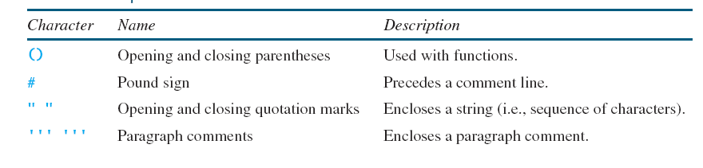
Special Symbols

Slide 31
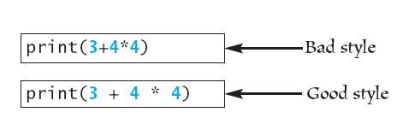
Programming Style and Documentation
Programming style: how programs look like
Easier for people to read, understand, and modify
Documentation: comments pertaining to program
Include a summary at the beginning of the program to explain what the program does, its key features
Include your name, class section, instructor, date, and a brief description at the beginning of the program
Indentation
A consistent spacing style makes programs clear and easy to read, debug, and maintain
Indent four spaces for nested blocks
Spacing
Use blank line to separate segments of the code
Add single space on both sides of separators

Slide 32
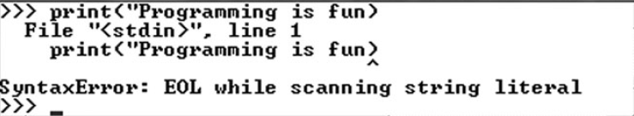
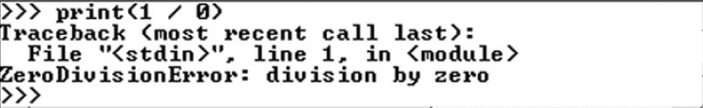
Programming Errors
Syntax Errors
Error in code construction
Runtime Errors
Causes the program to abort
Logic Errors
Produces incorrect result

Slide 33
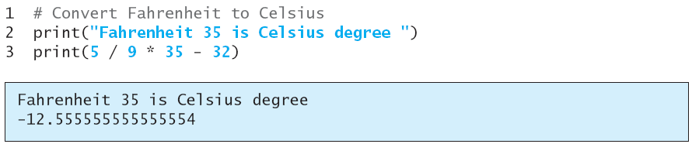
Programming Errors
Logic Errors
Produces incorrect result

Slide 34
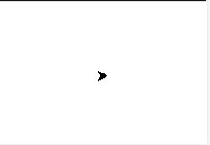
Getting Started with GUI Programming
Turtle is Python’s built-in graphics module for drawing lines, circles and other shapes
Drawing and adding color to a figure
The command to import all functions defined in the turtle module is:
import turtle
To show current location and direction of the turtle
turtle.showturtle()
turtle is the object for drawing graphics
Arrowhead indicates current position and direction of pen

Slide 35
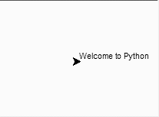
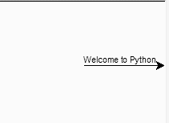
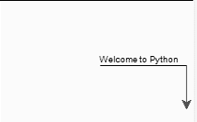
Getting Started with GUI Programming
To draw a text string “Welcome to Python”
turtle.write(“Welcome to Python”)
To draw a line in direction of arrow of 100 pixels
tutle.forward(100)
Turn arrowhead right 90 degrees, change color to red, and move forward by 50 pixels
turtle.right(90)
turtle.color(“red”)
turtle.forward(50)

Slide 36
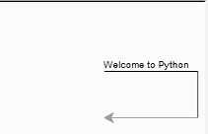
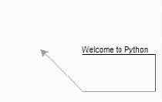
Getting Started with GUI Programming
Turn arrowhead right 90 degrees, change color to green, and move forward by 100 pixels
turtle.right(90)
turtle.color(“green”)
turtle.forward(100)
Turn arrowhead right 45 degrees, and draw a line with 80 pixels
turtle.right(45)
turtle.forward(80)

Slide 37
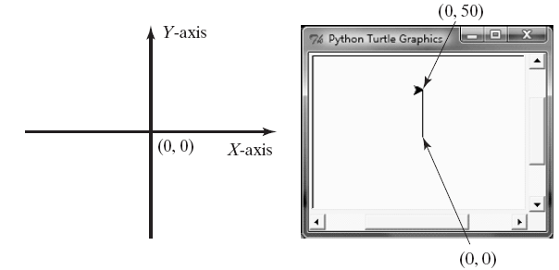
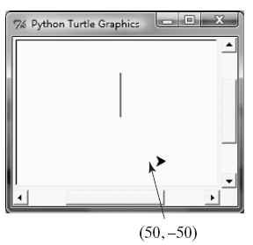
Getting Started with GUI Programming
When program starts arrowhead is at center of window (coordinates 0,0)
goto(x,y): go to points with (x,y) coordinates
turtle.goto(0,50)
To control whether to draw a line when pen is moved, use penup() and pendown()
turtle.penup()
turtle.goto(50,-50)
turtle.pendown()

Slide 38
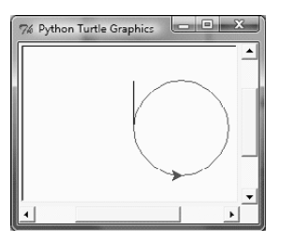
Getting Started with GUI Programming
To draw circle with radius 50 and red color
turtle.color(“red”)
turtle.circle(50)
turtle.circle(r): draw a circle with radius r whose center is r units left of current position

Slide 39
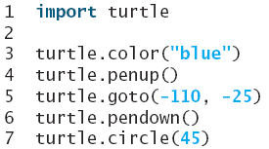
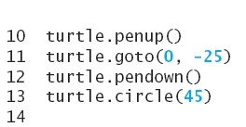
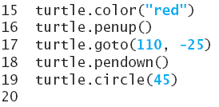
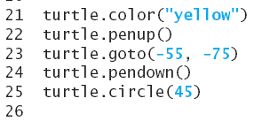
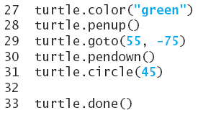
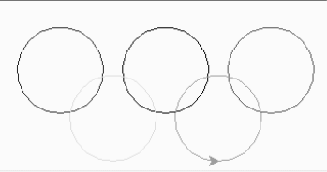
Getting Started with GUI Programming

Slide 40
Getting Started with GUI Programming
turtle.home() : move turtle to origin (0,0)
turtle.reset(): delete drawing from screen

